Slide 1
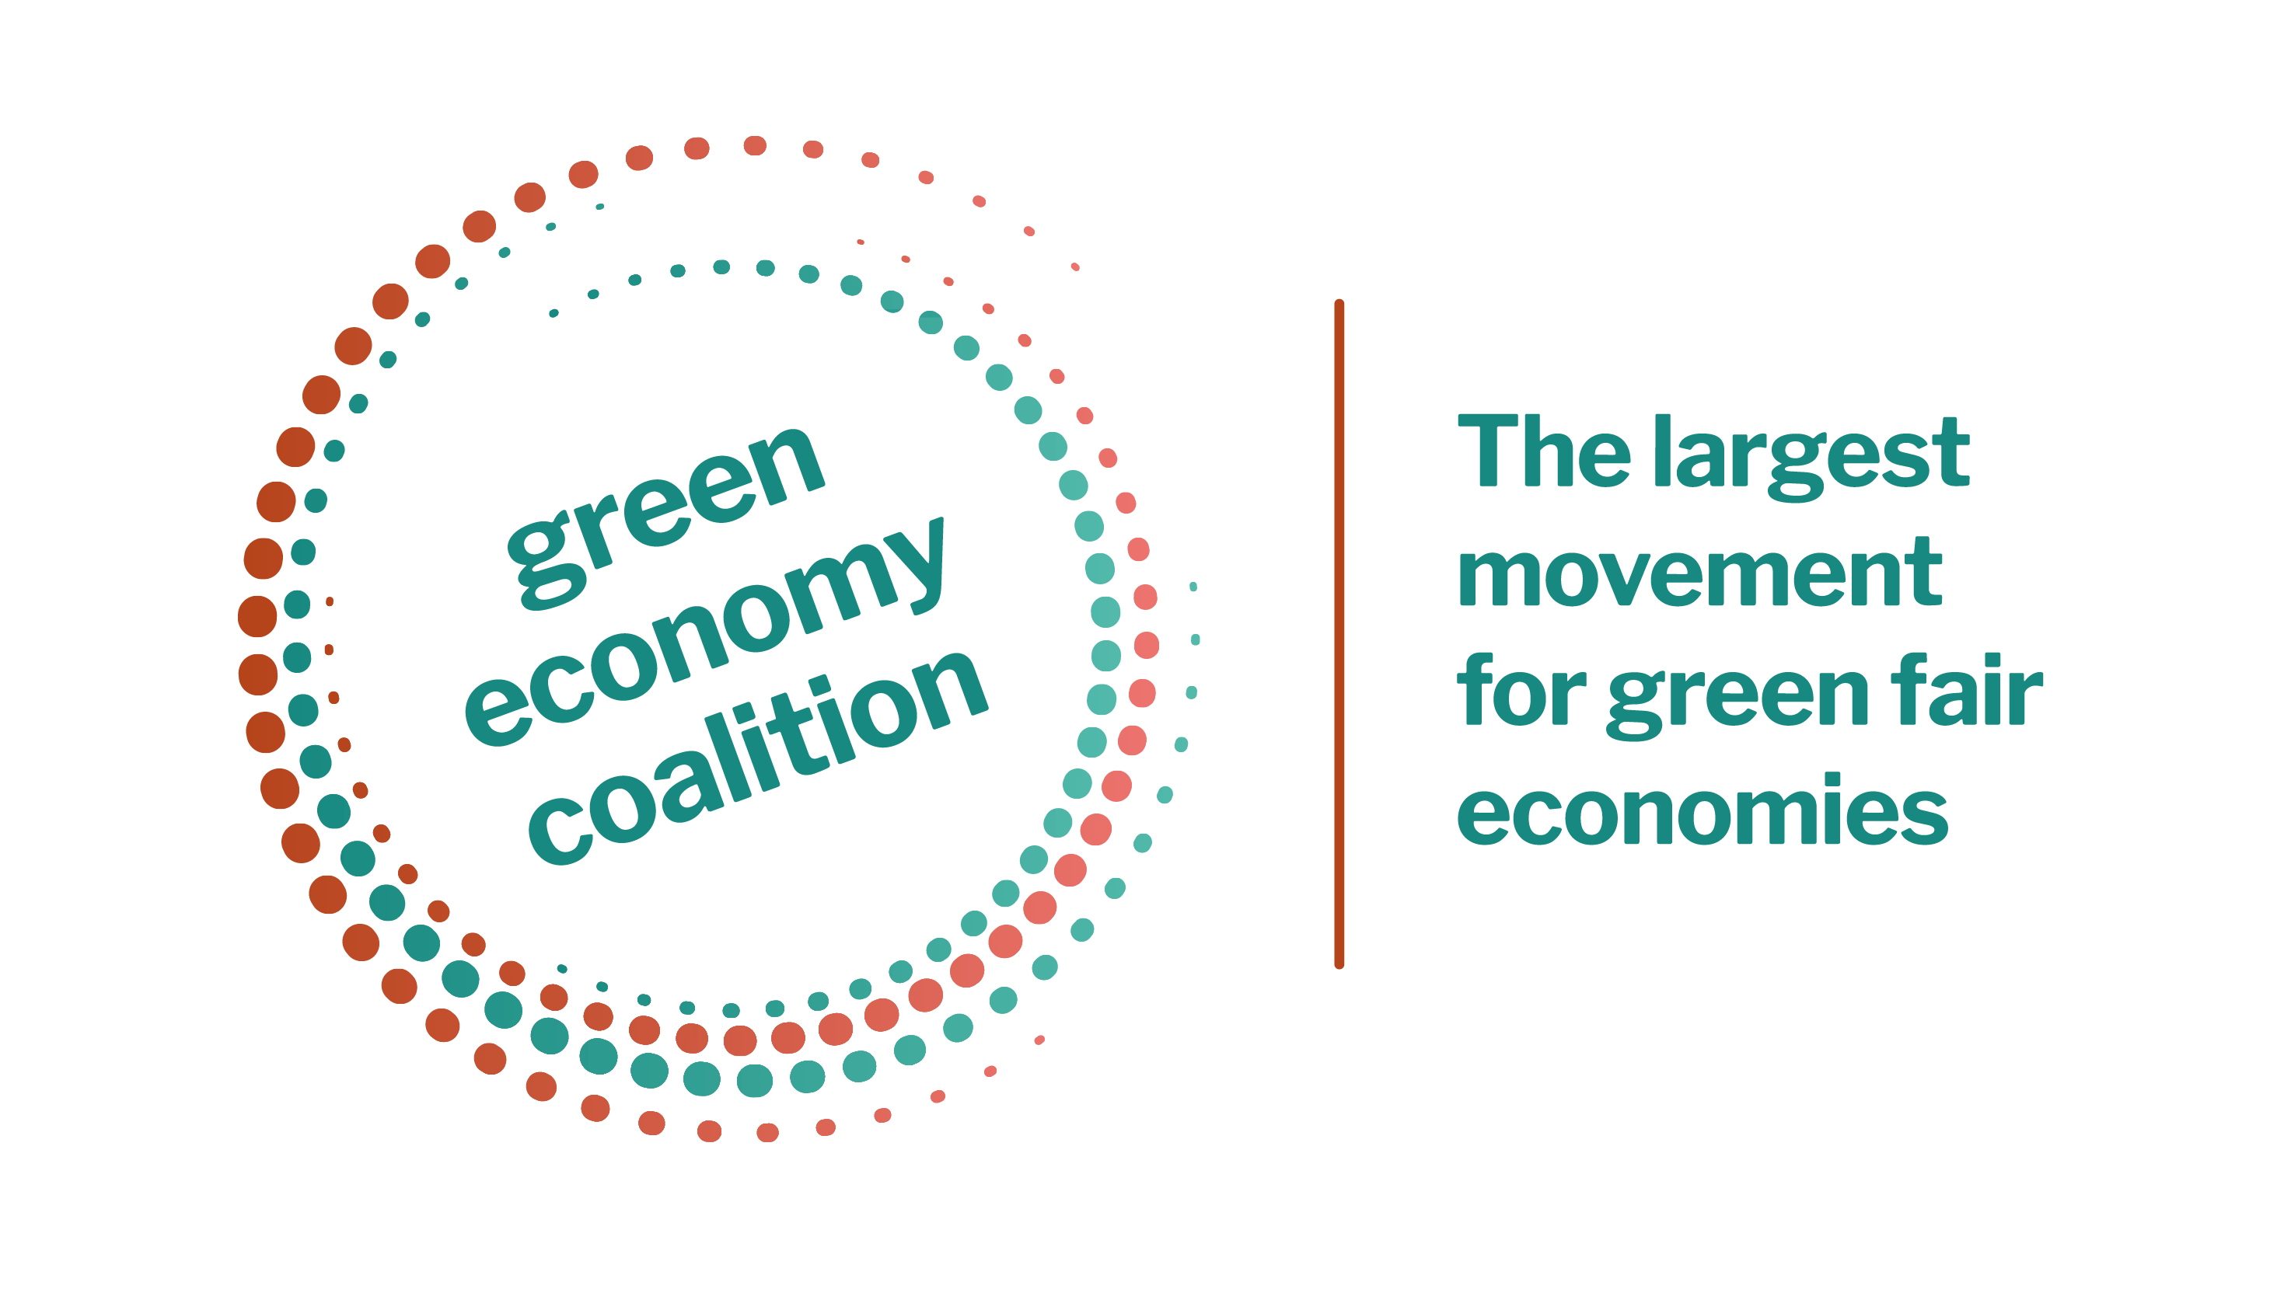

IIED Tracking Engagement on Green Economy Services – Wave on Wave
Global - IIED - Tracking Engagement - 2025

Slide 2
Background and Methodology
IIED – Tracking Engagement – Wave 2
  This report presents the findings of the Tracking Engagement on Green Economy Services research 2025. Savanta surveyed 10,152 people across ten countries from Monday, September 15, 2025 - Monday, October 13, 2025. The survey was conducted in English and translated into Portuguese, Standard Chinese, Spanish, Indonesian and Turkish in order to reach the following ten markets:
    Australia – 1,023 completes
    Brazil – 1,010 completes
    China – 1,011
    India – 1,006
    Indonesia – 1,027
    United Kingdom – 1,010*
    Nigeria – 1,030
    Peru – 1,018
    South Africa – 1,017
    Turkey – 1,000
This research tracks engagement of key audiences in green economy and circular economies to create usable insights for civil society to use in their engagement of audiences. The research will be conducted over 3 waves, with Wave 1 taking place in 2024, Wave 2 in 2025 and Wave 3 in 2026.
Data was weighted to be nationally representative by age, sex and region.
*New market this wave, previously Mexico in 2024. UK and Mexico not included in wave-on-wave comparisons

Slide 3
Reducing pollution and ensuring access to clean water and air are consistently seen as the most important steps for creating a fair and environmentally sustainable society
IIED – Tracking Engagement – Wave 2
*New answer option: The addition of a new answer option is likely the cause of the apparent decline across all other areas this wave. Given respondents are asked to rank answer options against each other, any new addition will have a knock-on impact.
Sample sizes: Wave 1 2024 (n = 9,083); Wave 2 2025 (n = 9,142) | Base = All respondents from Australia, Brazil, China, India, Indonesia, Nigeria, Peru, South Africa, Turkey | Q = "Please rank your top three of the following actions in order of importance for creating a fairer society while also protecting the environment. Rank from most important (1) to least important (3). " (Single choice) - NET Top 3 | Significance Level: 95%

Slide 4

IIED – Tracking Engagement – Wave 2
Emerging economies prioritise essential issues like pollution and clean water, while select countries champion balanced growth through policy and advocacy
Wave-on-wave shifts reveal softening support for economy–environment ‘win-wins’ and green jobs, while fundamentals remain robust
Generational Shifts & Wave-on-Wave Change
Key wave movements (Wave 1 2024 → Wave 2 2025)
    Balancing policy for current & future generations: 33% (W1) → 31% (W2)
    Affordable clean energy: 31% (W1) → 28% (W2)
    Green job opportunities: 29% (W1) → 25% (W2)
    Social inclusion via green development: 17% (W1) → 15% (W2)
Youth (18–24):
    Access to clean air: 36% (top choice for this age group)
    Focusing on creating jobs and growing the economy even if this means taking slower environmental action: 31% (vs 25% of 65+)
Seniors (65+):
    Balanced policy: 39% (vs 30% of 18–24)
    Pollution reduction: 38% (vs 34% of 18–24)
Peru and India exhibit the strongest focus on pollution reduction (44% and 40%, respectively), indicating mature and active environmental movements where public concern is likely translating into policy and advocacy.
Countries like Australia (51%), South Africa (44%), and Turkey (40%) rank top globally for prioritising universal access to clean water and air—well above the global average of 37%. This suggests that fundamental resource access is a more urgent or visible issue in these markets.
Turkey (48%) and Peru (38%) stand out for their emphasis on creating laws that balance economic growth and environmental protection, pointing to a public demand for integrated policy approaches rather than one-sided economic or ecological priorities.

Slide 5
Support for environmental priorities and policies remains high, though backing for stricter business regulations is significantly lower this wave
IIED – Tracking Engagement – Wave 2
Sample size: n = 18,225 | Base = All respondents from Australia, Brazil, China, India, Indonesia, Nigeria, Peru, South Africa, Turkey | Q = How much do you agree or disagree with the following statements? (Single choice) | Significance Level: 95%

Slide 6
Most agree that environmental protection should come before economic growth, yet significant declines were seen from 2024 to 2025 across all other statements
IIED – Tracking Engagement – Wave 2
Sample size: n = 18,225 | Base = All respondents from Australia, Brazil, China, India, Indonesia, Nigeria, Peru, South Africa, Turkey | Q = How much do you agree or disagree with the following statements? (Single choice) | Significance Level: 95%

Slide 7
IIED – Tracking Engagement – Wave 2
Global support for environmental action remains high, but cost sensitivity is rising in Wave 2
Public support for green policies and investment stays high, but willingness to accept personal cost has softened:
    Support for stricter business regulations, even if prices rise: 74% (W1) → 70% (W2)
    Willingness to pay more for eco-friendly products: 69% (W1) → 67% (W2)
    Support for higher taxes for environmental protection: 61% (W1) → 57% (W2)
    Prioritising environmental protection over economic growth: 74% (W1) → 73% (W2)
    Investment in clean energy as a top priority: 81% (W1) → 82% (W2)
Social justice support remains stable:
    75% believe a green economy will create more opportunities for marginalised groups
    This belief is strongest among younger respondents (78% 18-24 and 79% 25-34 vs 72% of 65+)
Global support for protecting natural resources over short-term economic gains remains exceptionally strong in Wave 2 (84%), with highest agreement in:
    India (88%)
    Nigeria (89%)
    Indonesia (87%)
    China (87%)

Slide 8
Seven in ten continue to prioritise environmental protection over economic growth, with little movement between waves
IIED – Tracking Engagement – Wave 2
Countries
70% globally choose environmental protection over economic growth, with standout support in:
  Turkey: 84%
  Indonesia: 79%
  China: 76%
  Brazil: 72%
Age
Strongest backing from ages 45-54 (globally): 73%
Sample size: n = 18,225 | Base = All respondents from Australia, Brazil, China, India, Indonesia, Nigeria, Peru, South Africa, Turkey | Q = "If you had to choose, which of the following would you prioritise?" (Single choice) | Significance Level: 95%

Slide 9
Willingness to make trade offs for environmental sustainability has remained steady for personal lifestyle changes and community initiatives – but noticeably declined for financial and economic sacrifices
IIED – Tracking Engagement – Wave 2
Sample size: n = 18,225 | Base = All respondents from Australia, Brazil, China, India, Indonesia, Nigeria, Peru, South Africa, Turkey | Q = "What are you willing to trade off to ensure environmental sustainability? " (Multiple choice) | Significance Level: 95%

Slide 10
Lack of government support remains the biggest barrier in making better choices. There was a significant decrease in the number of respondents saying there aren’t environmentally friendly options where they live
IIED – Tracking Engagement – Wave 2
Sample size: n = 18,225 | Base = All respondents from Australia, Brazil, China, India, Indonesia, Nigeria, Peru, South Africa, Turkey | Q = "What do you think makes it hard for you to make more choices that are better for the environment?" (Multiple choice) | Significance Level: 95%

Slide 11

IIED – Tracking Engagement – Wave 2
Barriers to greener choices: systemic issues drive everyday challenges, especially cost, government support and access to opportunities
Lack of government support is the top barrier – 52% globally; highest in Nigeria (67%), Turkey (62%), and South Africa (61%)
Cost is the next biggest obstacle: 41% globally say eco-friendly products are “too expensive”; peaks in Nigeria (67%), Peru (63%), Turkey (62%), South Africa (61%)
Difficulty finding green jobs or training is persistent (37% globally), with 40% of younger adults (25-34) citing this
Limited local options hinder action for 32% globally, especially in Peru (38%), India (36%), Nigeria (36%) and South Africa (35%)
19% globally say they “don’t know enough” about what to do

Slide 12
When pressed on the kind of government support needed, support for measures were largely equally distributed
IIED – Tracking Engagement – Wave 2
What kind of government support would help you make better choices for the environment?
Sample size: Wave 2 2025 (n = 9,142) | Base = All respondents from Australia, Brazil, China, India, Indonesia, Nigeria, Peru, South Africa, Turkey who say 'lack of support from the government' makes it hard to make more choices that are better for the environment | Q = "What kind of government support would help you make better choices for the environment? " (Multiple choice) | Significance Level: 95%

Slide 13
While responses to other statements remained stable, there was a significant increase in the belief that schools should teach children more about the environment and how to protect it
IIED – Tracking Engagement – Wave 2
Sample size: n = 18,225 | Base = All respondents from Australia, Brazil, China, India, Indonesia, Nigeria, Peru, South Africa, Turkey | Q = "How much do you agree or disagree with the following statements?" (Single choice) - NET Agree | Significance Level: 95%

Slide 14
Support for statements about increasing government action on climate change and legal consequences for environmental damage remains steady across both waves
IIED – Tracking Engagement – Wave 2
Sample size: n = 18,225 | Base = All respondents from Australia, Brazil, China, India, Indonesia, Nigeria, Peru, South Africa, Turkey | Q = "How much do you agree or disagree with the following statements?" (Single choice) - NET Agree | Significance Level: 95%

Slide 15

IIED – Tracking Engagement – Wave 2
Schools and government action remains crucial
Support for Environmental Education in Schools
93% globally agree that schools should teach children about environmental protection.
Support is highest in Nigeria (98%), Indonesia (97%), and South Africa (96%).
Australia shows lowest agreement at 83%.
Sense of Generational Duty on the Environment
Indonesia (96%) and Nigeria (95%) lead globally
China shows notably lower agreement: 84% (Wave 1), 88% (Wave 2)
South Africa agreement drops from 91% (W1) to 89% (W2), in contrast to the global trend of stability or rising support.

Slide 16
As a new option this wave, government support for green businesses has emerged as the top effective action, while almost all other actions experienced a significant increase this wave
IIED – Tracking Engagement – Wave 2
*New answer option: The addition of a new answer option is likely the cause of the apparent increase across all other areas this wave. Given respondents are asked to rank answer options against each other, any new addition will have a knock-on impact.
Sample sizes: Wave 1 2024 (n = 9,083); Wave 2 2025 (n = 9,142) | Base = All respondents from Australia, Brazil, China, India, Indonesia, Nigeria, Peru, South Africa, Turkey | Q = "Which of the following actions do you think would be most effective in protecting the environment and promoting sustainability right now?" (Multiple choice) | Significance Level: 95%

Slide 17
IIED – Tracking Engagement – Wave 2
Government support for green businesses tops the global list for most effective action (33%), edging out stricter industrial regulation and green jobs
Top 3 Most Effective Actions Chosen Globally:
1. Government support for green businesses:
    33% globally rate this as the most effective action.
    Peaks in the 18–24 age group (30%), in China (30%)
2. Stricter regulations on industrial pollution and waste management:
    31% globally
    Highest in Australia (38%), Peru (33%), and Brazil (32%)
3. Programs that create/promote employment in renewable energy and green sectors:
    31% globally
    Strongest with Indonesia (41%), Nigeria (38%) and China (34%)
Regional and Demographic Highlights:
Indonesia and Nigeria: Most likely to select programs that create and promote employment in renewable energy (41% and 38%)
Australia: Leads on stricter industrial regulation (38%)
18–24: Highest on programs that create and promote employment in renewable energy (33%)
65+: Highest on stricter regulations (36%)

Slide 18
Trust in political leaders to make the right decisions for a sustainable future remains low and largely unchanged from last wave
IIED – Tracking Engagement – Wave 2
NET Trust: 39%
Trust peaks in China (83%) and India (51%), while it remains much lower in South Africa (22%), Australia (29%) and Turkey (29%).
Parents are significantly more likely to trust political leaders (43%) than non-parents (33%)
Overall trust levels are slightly lower vs last wave
NET Trust: 41%
Sample sizes: Wave 1 2024 (n = 9,083); Wave 2 2025 (n = 9,142) | | Base = All respondents from Australia, Brazil, China, India, Indonesia, Nigeria, Peru, South Africa, Turkey | Q = "How much do you trust that political leaders will make the right decisions for a sustainable future? " (Single choice) | Significance Level: 95%

Slide 19
Agreement that the current generation is doing enough for a sustainable future has decreased significantly this wave, while disagreement remains steady
IIED – Tracking Engagement – Wave 2
NET Agree: 47%
NET Agree: 45%
45% agree the current generation is doing enough for the next generation
  Highest levels of disagreement are found in Turkey (48%), Brazil (44%) and South Africa (42%)
30% of parents disagree
Disagreement is especially acute among those who distrust political leaders (53% disagree)
Sample sizes: Wave 1 2024 (n = 9,083); Wave 2 2025 (n = 9,142) | | Base = All respondents from Australia, Brazil, China, India, Indonesia, Nigeria, Peru, South Africa, Turkey | Q = "How much do you agree or disagree that the current generation is doing enough to ensure a sustainable future for the next generations?" (Single choice) | Significance Level: 95%

Slide 20
Overall, respondents felt that they personally were taking more action than the previous year to protect the environment
IIED – Tracking Engagement – Wave 2
69% globally say they personally are taking more action than last year
  Highest in India (82%), China (79%), Nigeria (79%)
  Lowest in Australia (46%)
46% think other people in their country are stepping up
  Strongest in China (66%) and India (61%), drops in Turkey (33%), Peru (34%) and Australia (35%)
42% believe their government is taking more action
  Highest in India (61%)
  Very low in Peru (15%), Turkey (32%), Brazil (33%) and South Africa (33%)
NET More action: 42%
NET More action: 69%
Sample size: Wave 2 2025 (n = 9,142) | Base = All respondents from Australia, Brazil, China, India, Indonesia, Nigeria, Peru, South Africa, Turkey | Q = "Compared to last year, how much action do you think each of the following is taking to protect the environment?" (Single choice) - You, personally | Significance Level: 95%

Slide 21
Most people support the idea that companies should openly share their environmental efforts, even if it invites criticism. Comparatively, concerns about politicians' actions, economic priorities, and affordability reflect more mixed opinions
IIED – Tracking Engagement – Wave 2
NET Agree:
76%
44%
55%
Sample size: Wave 2 2025 (n = 9,142) | Base = All respondents from Australia, Brazil, China, India, Indonesia, Nigeria, Peru, South Africa, Turkey | Q = "How much do you agree or disagree with the following statements?" (Single choice) - Companies should openly share what they do to protect the environment, even if some people might criticise them | Significance Level: 95%

Slide 22


Abby Tucker
Emma Beashel
Senior Consultant
Senior Executive
Abby.Tucker@Savanta.com
emma.beashel@savanta.com

